Slide 1


Building better security for your API platform Using Azure API Management
Eldert Grootenboer

Slide 2


Eldert Grootenboer
@egrootenboer

Slide 3

Why API security?

Slide 4
APIs are everywhere
API calls represent 83 percent of web traffic, according to an October 2018 Akamai traffic review detailed in the report.
Akamai press release

Slide 5
API security is important
Reports suggest that by 2022, API abuses will be the vector most responsible for data breaches within enterprise web applications.
Erez Yalon

Slide 6
API security breaches
I Scraped Millions of Venmo Payments. Your Data Is at Risk
Facebook Security Breach Exposes Accounts of 50 Million Users
Major US Postal Service data breach exposes 60m users
Brazil's largest professional association suffers massive data leak
Data breach at JustDial leaks 100 million user details

Slide 7

Security should be of prime importance

Slide 8
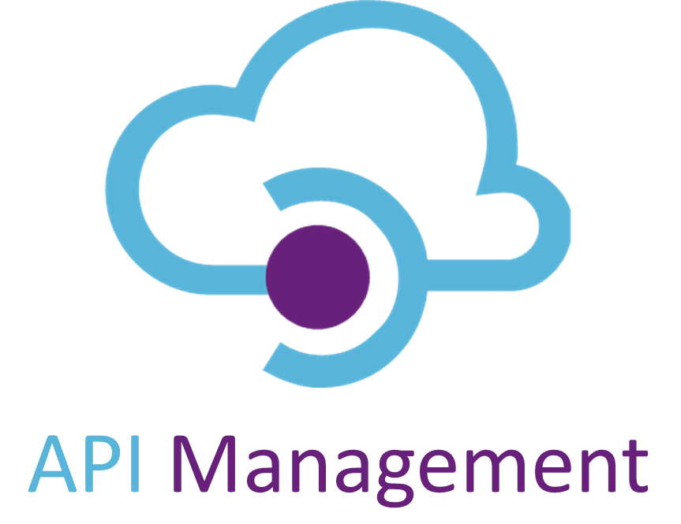
Better security with Azure

Slide 9



Solving our API strategy challenges
Connected experiences
Abstract
Secure and protect
Smarter services
Manage lifecycle
Monitor and measure
Discover
Get access
Try
Code samples
Consume
Mediate
Publish
APIs
App Developers
(use APIs)
Developer portal
Gateway
Azure portal
API Publishers
(provide APIs)
Services and data
Notes:
Talk about the challenge, and how API Management solves each of these.
Rustig spreken!

Slide 10
Smarter services with policies
Security
Caching
Integration
Throttling
Quota limits
Transformations
Mocking
And many more…

Slide 11
Complementing services
Notes:
Block suspicious requests
Forward valid requests
Include data for authorization
Key
OAuth 2 & OpenID Connect
Client certificate
Custom authN/authZ
IP filter
Rate limits and quotas
Accept requests from a trusted source
Perform fine-grained authorization
HTTP Basic
Mutual certificate
Managed identity
IP filter

Slide 12

Crteating an API strategy

Slide 13
The different stages of an API strategy
Private APIs
1
Limited access to partners
2
Publicly exposed APIs
3

Slide 14
More open, more risks
Exposing valuable data
Easily accessible infrastructure
Inadequate authentication or authorization
Not following best practices
Missing monitoring capabilities

Slide 15

API security best practices

Slide 16
Best practices for securing APIs
Encryption
Authentication
OAuth & OpenID Connect
Call Security Experts
Audit, Log and Version
Share as Little as Possible
System Protection with Throttling and Quotas
Data Validation
Infrastructure
OWASP top 10
API Firewalling
API Gateway
Notes:
https://apifriends.com/api-security/api-security-best-practices/
1. Encryption
Be cryptic. Nothing should be in the clear, for internal or external communications.
You and your partners should cipher all exchanges with TLS (the successor to SSL), whether it is one-way encryption (standard one-way TLS) or even better, mutual encryption (two-way TLS).
Use the latest TLS versions to block the usage of the weakest cipher suites.
2. Authentication
Don’t talk to strangers. You should always know who is calling your APIs, at least through an API key (asymmetric key) or basic access authentication (user/password), to increase the difficulty to hack your system.
3. OAuth & OpenID Connect
Delegate all Responsibility. A good manager delegates responsibility and so does a great API. You should be delegating authorization and/or authentication of your APIs.
What is OAuth? It is a magical mechanism preventing you from having to remember ten thousand passwords. Instead of creating an account on every website, you can connect through another provider’s credentials, for example, Facebook or Google. For APIs, it works the same way: the API provider relies on a third-party server to manage authorizations. The consumer doesn’t give their credentials but instead gives a token provided by the third-party server. It protects the consumer as they don’t disclose their credentials, and the API provider doesn’t need to care about protecting authorization data, as it only receives tokens.
OAuth is a commonly used delegation protocol to convey authorizations. To secure your APIs even further and add authentication, you can add an identity layer on top of it: this is the Open Id Connect standard, extending OAuth 2.0 with ID tokens.
4. Call Security Experts
You should use experienced Antivirus systems or ICAP (Internet Content Adaptation Protocol) servers to help you with security.
5. Monitoring: Audit, Log and Version
Be a stalker. You need to be ready to troubleshoot in case of error: to audit and log relevant information on the server – and keep that history as long as it is reasonable in terms of capacity for your production servers. You should turn your logs into resources for debugging in case of any incidents. Also, monitoring dashboards are highly recommended tools to track your API consumption.
Do not forget to add the version on all APIs, preferably in the path of the API, to offer several APIs of different versions working at the same time, and to be able to retire and depreciate one version over the other.
6. Share as Little as Possible
Be paranoid. Display as little information as possible in your answers, especially in error messages. Lockdown email subjects and content to predefined messages that can’t be customized. Because IP addresses can give locations, keep them for yourself. Use IP Whitelist and IP Blacklist, if possible, to restrict access to your resources. Limit the number of administrators, separate access into different roles, and hide sensitive information in all your interfaces.
7. System Protection with Throttling and Quotas
Throttle yourself. You should restrict access to your system to a limited number of messages per second, to protect your backend system bandwidth according to your servers’ capacity.
You should also restrict access by API and by the user (or application) to be sure that no one will abuse the system or anyone API in particular.
Throttling limits and quotas – when well set – are crucial to prevent attacks coming from different sources flooding your system with multiple requests (DDOS – Distributed Denial of Service Attack).
8. Data Validation
Be picky and refuse surprise gifts, especially if they are big. You should check everything your server accepts. Be careful to refuse any added content, data that is too big, and always check the content that consumers are sending you. Use JSON or XML schema validation and check that your parameters are what they should be (string, integer…) to prevent any SQL injection or XML bomb.
9. Infrastructure
Network and be up to date. A good API should lean on a good security network, infrastructure and up-to-date software (for servers, load balancers) to be solid and always benefit from the latest security fixes.
10. OWASP top 10
Avoid wasps. The OWASP (Open Web Application Security Project) top 10 is a list of the 10 worst vulnerabilities, ranked according to their exploitability and impact. In addition to the above points, to review your system, make sure you have secured all the OWASP vulnerabilities.
11. API Firewalling
Build a wall. For some people, building a wall can solve all the immigration problems. This is the case, for APIs at least! Your API security should be organized into two layers:
The first layer is in DMZ, with an API firewall to execute basic security mechanisms like checking the message size, SQL injections and any security based on the HTTP layer, blocking intruders early. Then forward the message to the second layer.
The second layer is in LAN with advanced security mechanisms on the content of data.
12. API Gateway (API Management)
Gateway to heaven. All the above mechanisms are long to implement and maintain. Instead of reinventing the wheel, you should opt for a mature and performant API Management solution with all these options to save your money, time and resources, and increase your time to market. An API Gateway will help you secure, control and monitor your traffic. In addition to helping you secure your APIs easily, an API Management solution will help you make sense of your API data, to take technical and business decisions: the key to success!

Slide 17
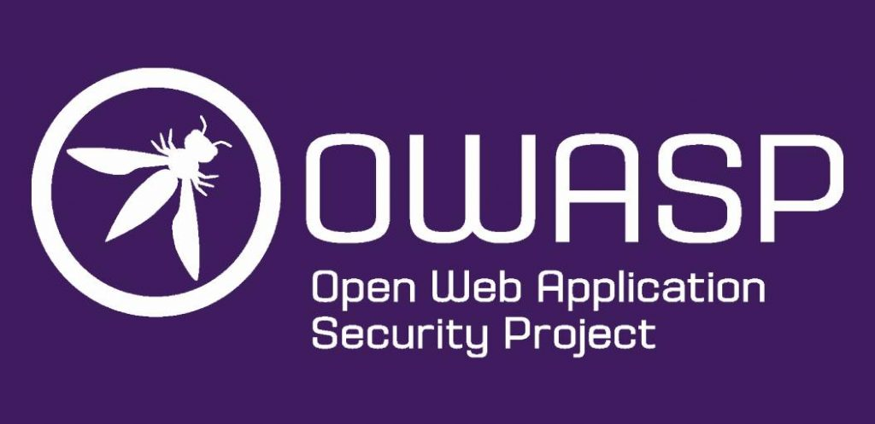
OWASP

Slide 18
OWASP API Security Top 10
Broken object level authorization
Broken authentication
Excessive data exposure
Lack of resources and rate limiting
Broken function level authorization
Mass assignment
Security misconfiguration
Injection
Improper assets management
Insufficient logging and monitoring
Notes:
https://apisecurity.io/encyclopedia/content/owasp-api-security-top-10-cheat-sheet-a4.pdf
Broken Object Level Authorization
APIs tend to expose endpoints that handle object identifiers, creating a wide attack surface Level Access Control issue. Object level authorization checks should be considered in every function that accesses a data source using an input from the user.
Broken User Authentication
Authentication mechanisms are often implemented incorrectly, allowing attackers to compromise authentication tokens or to exploit implementation flaws to assume other user’s identities temporarily or permanently. Compromising system’s ability to identify the client/user, compromises API security overall.
Excessive Data Exposure
Looking forward to generic implementations, developers tend to expose all object properties without considering their individual sensitivity, relying on clients to perform the data filtering before displaying it to the user.
Lack of Resources & Rate Limiting
Quite often, APIs do not impose any restrictions on the size or number of resources that can be requested by the client/user. Not only can this impact the API server performance, leading to Denial of Service (DoS), but also leaves the door open to authentication flaws such as brute force.
Broken Function Level Authorization
Complex access control policies with different hierarchies, groups, and roles, and an unclear separation between administrative and regular functions, tend to lead to authorization flaws. By exploiting these issues, attackers gain access to other users’ resources and/or administrative functions.
Mass Assignment
Binding client provided data (e.g., JSON) to data models, without proper properties filtering based on a whitelist, usually lead to Mass Assignment. Either guessing objects properties, exploring other API endpoints, reading the documentation, or providing additional object properties in request payloads, allows attackers to modify object properties they are not supposed to.
Security Misconfiguration
Security misconfiguration is commonly a result of unsecure default configurations, incomplete or ad-hoc configurations, open cloud storage, misconfigured HTTP headers, unnecessary HTTP methods, permissive Cross-Origin resource sharing (CORS), and verbose error messages containing sensitive information.
Injection
Injection flaws, such as SQL, NoSQL, Command Injection, etc., occur when untrusted data is sent to an interpreter as part of a command or query. The attacker’s malicious data can trick the interpreter into executing unintended commands or accessing data without proper authorization.
Improper Assets Management
APIs tend to expose more endpoints than traditional web applications, making proper and updated documentation highly important. Proper hosts and deployed API versions inventory also play an important role to mitigate issues such as deprecated API versions and exposed debug endpoints.
Insufficient Logging & Monitoring
Insufficient logging and monitoring, coupled with missing or ineffective integration with incident response, allows attackers to further attack systems, maintain persistence, pivot to more systems to tamper with, extract, or destroy data. Most breach studies demonstrate the time to detect a breach is over 200 days, typically detected by external parties rather than internal processes or monitoring.

Slide 19

Demo time!

Slide 20
Broken authentication
Unprotected APIs
Weak authentication
Lack of access token validation
Notes:
Broken User Authentication
Authentication mechanisms are often implemented incorrectly, allowing attackers to compromise authentication tokens or to exploit implementation flaws to assume other user’s identities temporarily or permanently. Compromising system’s ability to identify the client/user, compromises API security overall.

Slide 21
Excessive data exposure
Full data objects returned
Filtering on client
Secure information exposed
Notes:
Excessive Data Exposure
Looking forward to generic implementations, developers tend to expose all object properties without considering their individual sensitivity, relying on clients to perform the data filtering before displaying it to the user.

Slide 22
Lack of resources and rate limiting
Brute force attacks
Denial of Service
Excessive request size
Notes:
Excessive Data Exposure
Looking forward to generic implementations, developers tend to expose all object properties without considering their individual sensitivity, relying on clients to perform the data filtering before displaying it to the user.

Slide 23
Security misconfigurations
Misconfigured HTTP headers
Unnecessary HTTP methods
Verbose error messages
Notes:
Security Misconfiguration
Security misconfiguration is commonly a result of unsecure default configurations, incomplete or ad-hoc configurations, open cloud storage, misconfigured HTTP headers, unnecessary HTTP methods, permissive Cross-Origin resource sharing (CORS), and verbose error messages containing sensitive information.

Slide 24
Insufficient logging and monitoring
Lack of logging, monitoring, alerting
Logs not integrated
Relying on manual checks
Notes:
Insufficient Logging & Monitoring
Insufficient logging and monitoring, coupled with missing or ineffective integration with incident response, allows attackers to further attack systems, maintain persistence, pivot to more systems to tamper with, extract, or destroy data. Most breach studies demonstrate the time to detect a breach is over 200 days, typically detected by external parties rather than internal processes or monitoring.

Slide 25

Almost done…

Slide 26
API Management to the rescue
# | OWASP API Top 10 (2019) | Mitigations and preventive measures
1 | Broken Object Level Authorization | Area of investment
2 | Broken Authentication | Key/token/certificate-based authentication Request transformation
3 | Excessive Data Exposure | Filtering or masking sensitive data
4 | Lack of Resources & Rate Limiting | Throttling and quota limit Backend concurrency
5 | Broken Function Level Authorization | Key/token-based authorization Custom authorization
6 | Mass assignment | Area of investment
7 | Security misconfigurations | TLS enforcement and configuration CORS Sanitization of response headers and error messages;
8 | Injection | Area of investment
9 | Improper Assets Management | Up-to-date API catalog API lifecycle management
10 | Insufficient logging and monitoring | Logging
Notes:
Broken Object Level Authorization
APIs tend to expose endpoints that handle object identifiers, creating a wide attack surface Level Access Control issue. Object level authorization checks should be considered in every function that accesses a data source using an input from the user.
Broken User Authentication
Authentication mechanisms are often implemented incorrectly, allowing attackers to compromise authentication tokens or to exploit implementation flaws to assume other user’s identities temporarily or permanently. Compromising system’s ability to identify the client/user, compromises API security overall.
Excessive Data Exposure
Looking forward to generic implementations, developers tend to expose all object properties without considering their individual sensitivity, relying on clients to perform the data filtering before displaying it to the user.
Lack of Resources & Rate Limiting
Quite often, APIs do not impose any restrictions on the size or number of resources that can be requested by the client/user. Not only can this impact the API server performance, leading to Denial of Service (DoS), but also leaves the door open to authentication flaws such as brute force.
Broken Function Level Authorization
Complex access control policies with different hierarchies, groups, and roles, and an unclear separation between administrative and regular functions, tend to lead to authorization flaws. By exploiting these issues, attackers gain access to other users’ resources and/or administrative functions.
Mass Assignment
Binding client provided data (e.g., JSON) to data models, without proper properties filtering based on a whitelist, usually lead to Mass Assignment. Either guessing objects properties, exploring other API endpoints, reading the documentation, or providing additional object properties in request payloads, allows attackers to modify object properties they are not supposed to.
Security Misconfiguration
Security misconfiguration is commonly a result of unsecure default configurations, incomplete or ad-hoc configurations, open cloud storage, misconfigured HTTP headers, unnecessary HTTP methods, permissive Cross-Origin resource sharing (CORS), and verbose error messages containing sensitive information.
Injection
Injection flaws, such as SQL, NoSQL, Command Injection, etc., occur when untrusted data is sent to an interpreter as part of a command or query. The attacker’s malicious data can trick the interpreter into executing unintended commands or accessing data without proper authorization.
Improper Assets Management
APIs tend to expose more endpoints than traditional web applications, making proper and updated documentation highly important. Proper hosts and deployed API versions inventory also play an important role to mitigate issues such as deprecated API versions and exposed debug endpoints.
Insufficient Logging & Monitoring
Insufficient logging and monitoring, coupled with missing or ineffective integration with incident response, allows attackers to further attack systems, maintain persistence, pivot to more systems to tamper with, extract, or destroy data. Most breach studies demonstrate the time to detect a breach is over 200 days, typically detected by external parties rather than internal processes or monitoring.

Slide 27



Thank You!
@egrootenboer
eldert@eldert.net
https://www.linkedin.com/in/eldert-grootenboer
Notes:
Rustig spreken!

